Slide 1
Pose Estimation on Google Coral Edge TPU Dev Board
ZHI Xiaoying
WANG Xuan
08/07/2019

Slide 2
Motivation & Purpose
Recap of previous work
Working process
Obstacle & next stage
Outline
Notes:
Firstly I will introduce the background and motivation for this topic, and then briefly recap my previous work. I will then introduce the experiment I did and the data we’ve got. Following is the methodology utilized in this project, and then the computer experiment with results and analysis. A conclusion and discussion will be covered later.

Slide 3
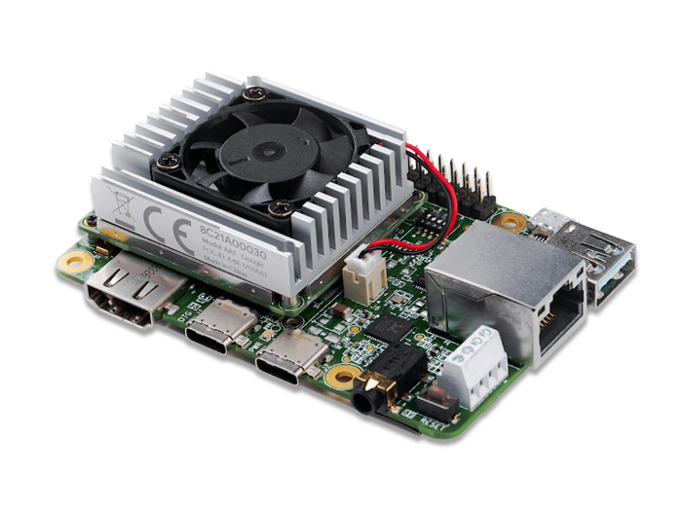
Motivation
Purpose
Animal pose estimation
Accurate
Fast
Non-invasive
Adjustable
Portable
Tools
Electrodes on joints (invasive)
Human pose estimation via NN
DeepLabCut: Animal pose estimation via NN
Pose estimation on portable device
Google Coral Dev Board
Edge TPU
Trained NN
Video/frame under test
Predicted pose
Notes:
Before everything let’s have a look at the background and find the motivation.
BOTDA, Brillouin optical time domain analyzer, is a widely-adopted distributed long-distance fiber optic sensor that can achieve a high spatial resolution to meters and even centimeters. Two counter-propagating waves, the pump wave and the probe wave, encounter and generate stimulated Brillouin scattering, which gives rise to Brillouin frequency shift in the output wave. If we gather the data at a series of frequencies, a Brillouin gain spectrum can be drawn and BFS can be detected from the gain spectrum. With a verified linear dependency between the frequency shift and the environmental temperature or strain, the temperature or strain can be calculated from the frequency shift.
Due to these characteristics of BOTDA, it can be and have been used in scenarios such as structural health monitoring, oil and gas monitoring, highway safety monitoring and submarine cable monitoring.
However, the signals collected from BOTDA often have large noise, and denoising is necessary to get a clear signal for Brillouin frequency shift detection. Conventionally denoising is performed by averaging, provided the assumption that the noise is white Gaussian noise. It was later brought up that advanced signal denoising algorithms can be applied to the data directly, so to reduce the averaging time, and the measurement time is reduced. Clearer signals from better denoising performances can also help increase the accuracy in plotting Brillouin gain spectrum and Brillouin frequency shift detection. Among the signal processing techniques, image denoising, and especially non-local means, will be our focus here.
The main scope of this project is then, firstly to inspect the algorithm’s performance under different specifications, and then to find appropriate and practical metrics for evaluation.

Slide 4
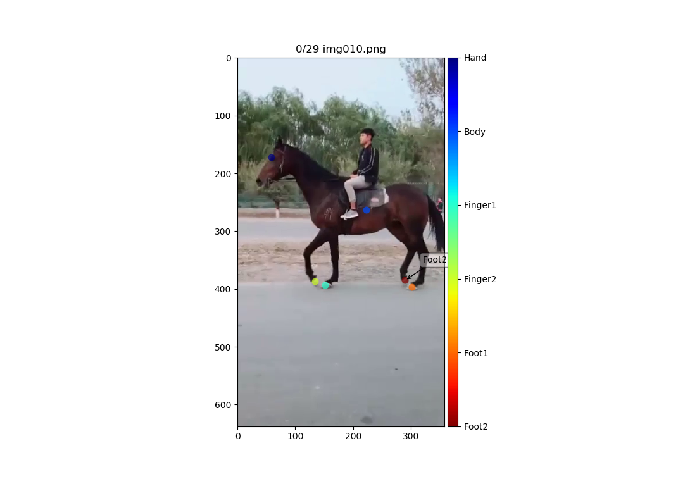

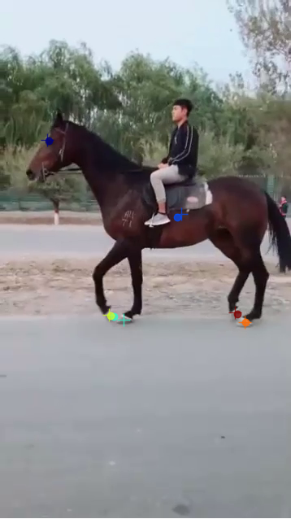
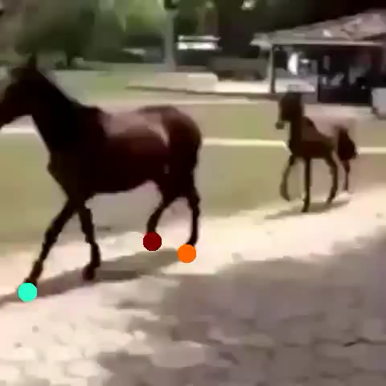
Recap: DeepLabCut ToolBox
Training data
Labeled frames
Test data
Predicted video

Slide 5
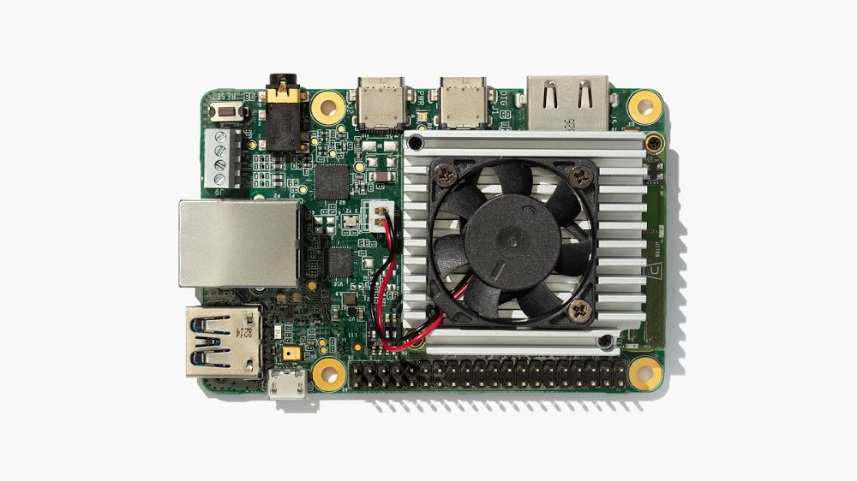
Google Coral
OS: Mendel Linux (Deriv. of Debian)
Audio, Video & GPIO
Language: Python & C++
Framework: Tensorflow Lite

Slide 6

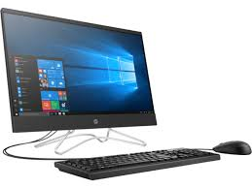
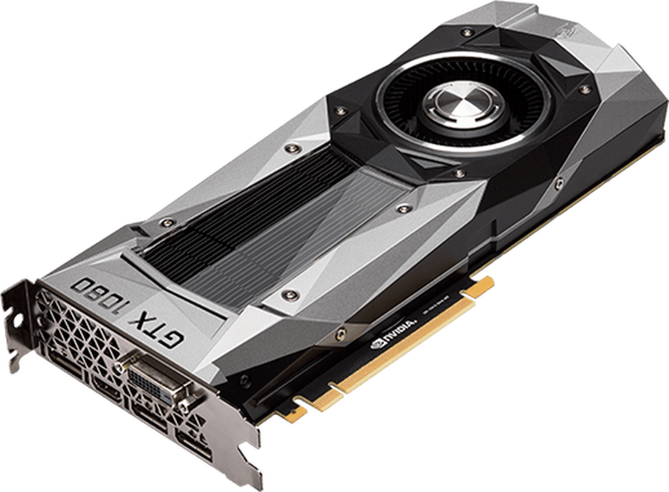
Working process
Neural Network
Train
Evaluate
Predict
Model
Coral
?

Slide 7
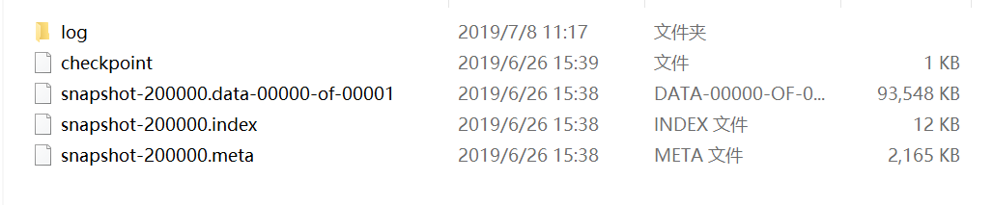
Trained Model (TF)
Model (TF Lite)
Compiled
Edge TPU
Import model to Coral
.ckpt
.pb
.tflite

Slide 8
From .tflite to Coral

Slide 9
Next step
What we can do now
Convert from trained model to .tflite
Load compiled .tflite to Coral
Predictions on Coral
What we want to do later
Re-train under quantization-aware conditions
Convert from trained model to .tflite
Load compiled .tflite to Coral
Predictions on Coral

Slide 10
Thank you

Slide 11
DeepLabCut
Features
Integrated toolbox on Linux
GUI for labeling
Small training dataset with decent results
Generalizes well to all kinds of animals, movements, illuminations, etc.
Limitations
Only predicts visible body parts
Mathis et al. Nature Neuroscience 2018
Based on DeeperCut (Insafutdinov et al., ECCV 2016)
Pretrained ResNet + deconv layers
Functions
Selecting training frames
Checking human annotator labels
Generating training data
Evaluating performance on test frames
Extract postures from novel videos

